Slide 1
Lewes WWTF Long-Range Planning Study Lewes BPW Public Meeting April 12, 2023

Slide 2
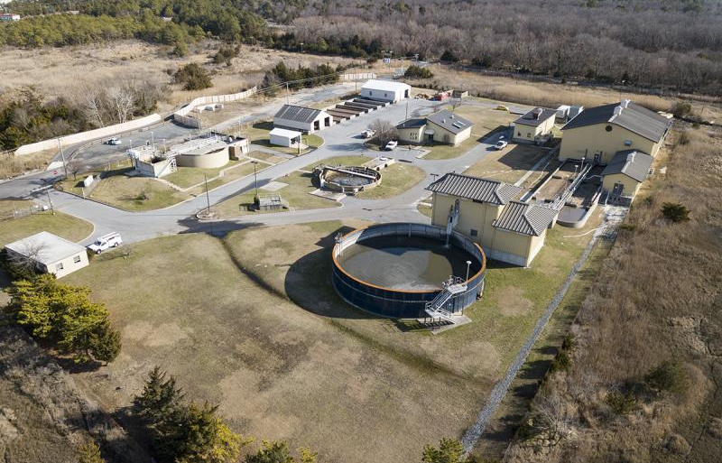
Agenda
Option 1 Visualizations
Cost Estimates
Water Quality Criteria
Cape Gazette – Nick Roth Photo

Slide 3
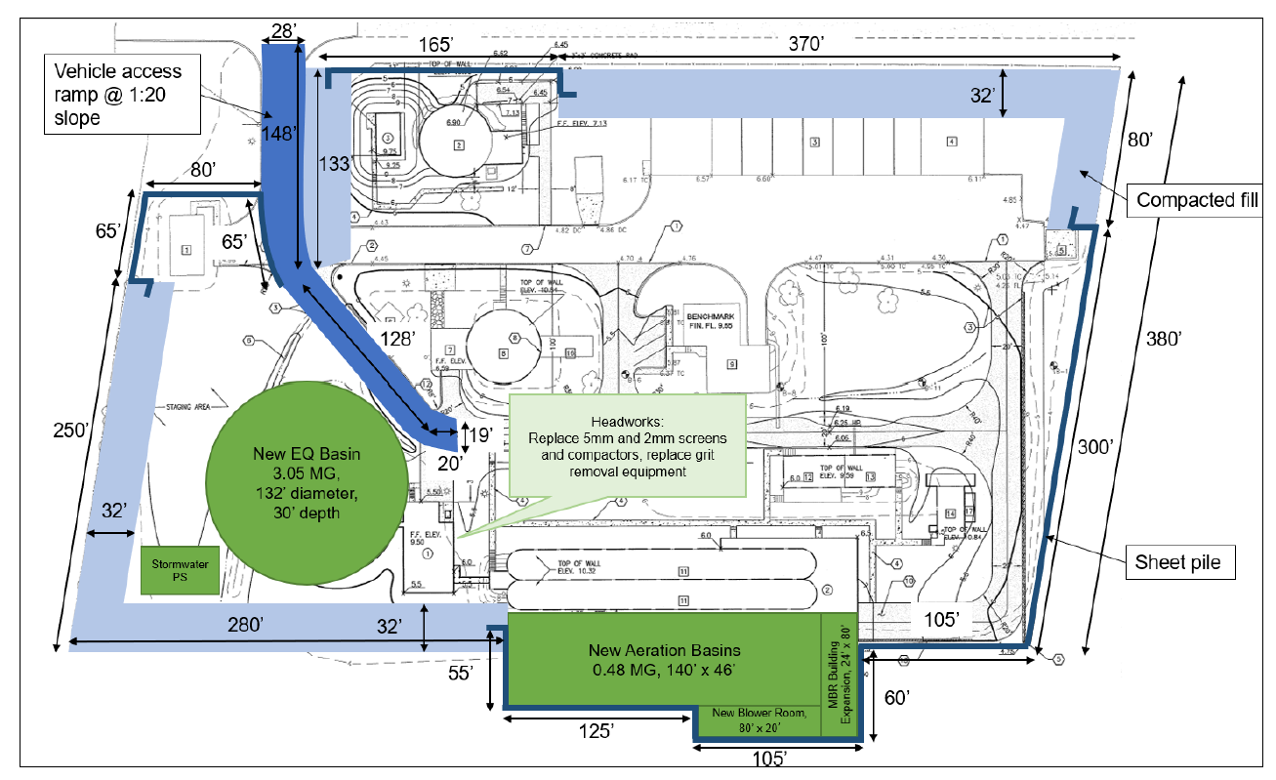
1. Option 1 Visualizations
Option 1 (Existing Site Hardening) upgrades include a new perimeter flood barrier and new treatment structures
BPW has worked with GHD to generate visualizations for how the site would look following implementation of the Option 1 upgrades

Slide 4
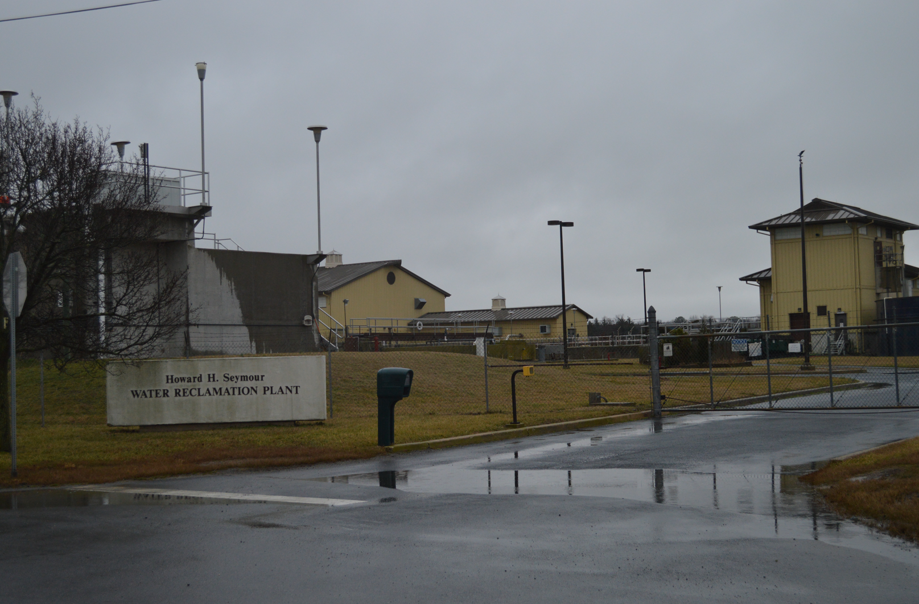
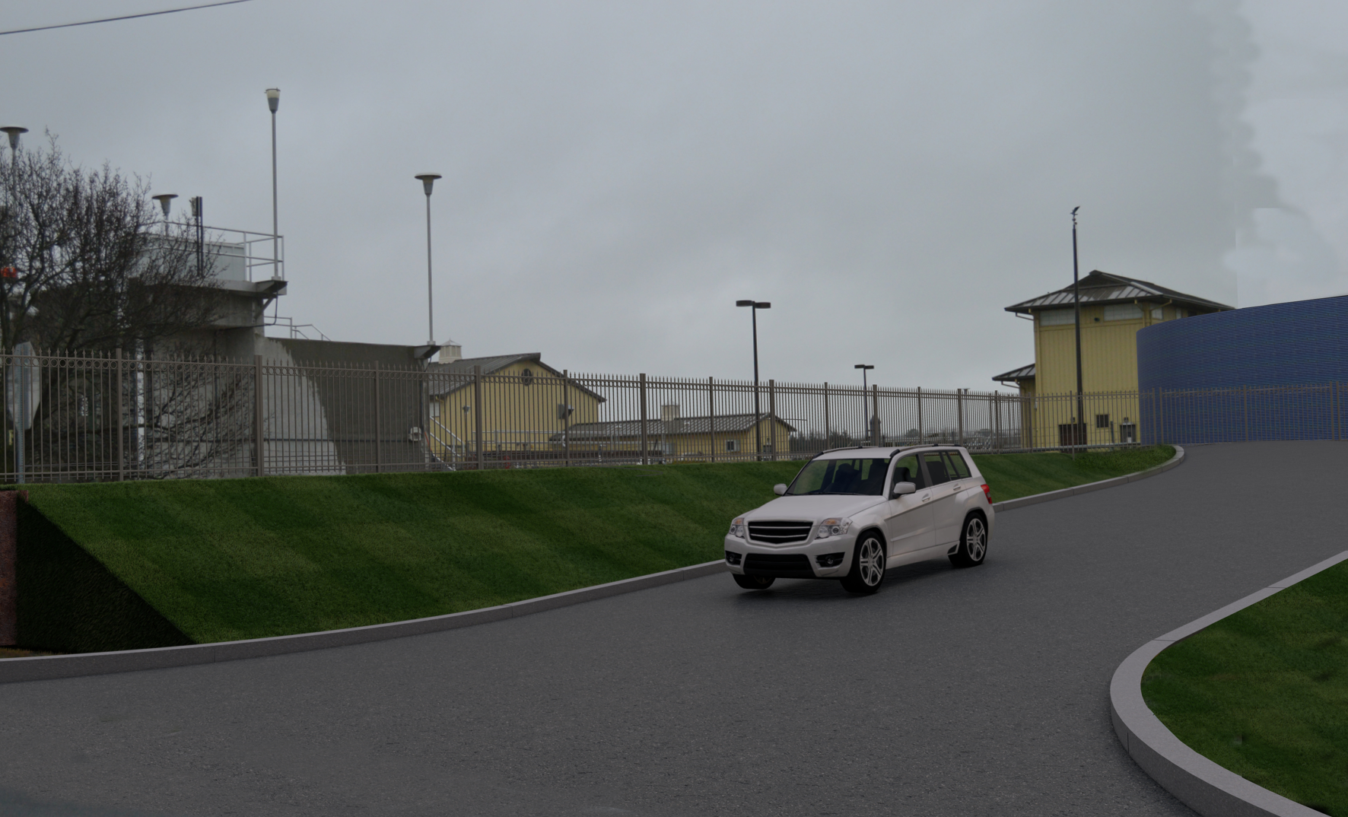
1. Option 1 Visualizations
1
View No. 1 – site entrance viewed from American Legion Road
BEFORE
AFTER

Slide 5
1. Option 1 Visualizations
1
View No. 1 – site entrance viewed from American Legion Road
NEW 3.05 MG Flow Equalization Tank
NEW Site Fence
NEW Perimeter flood barrier: compacted earth fill
NEW Vehicle access ramp

Slide 6
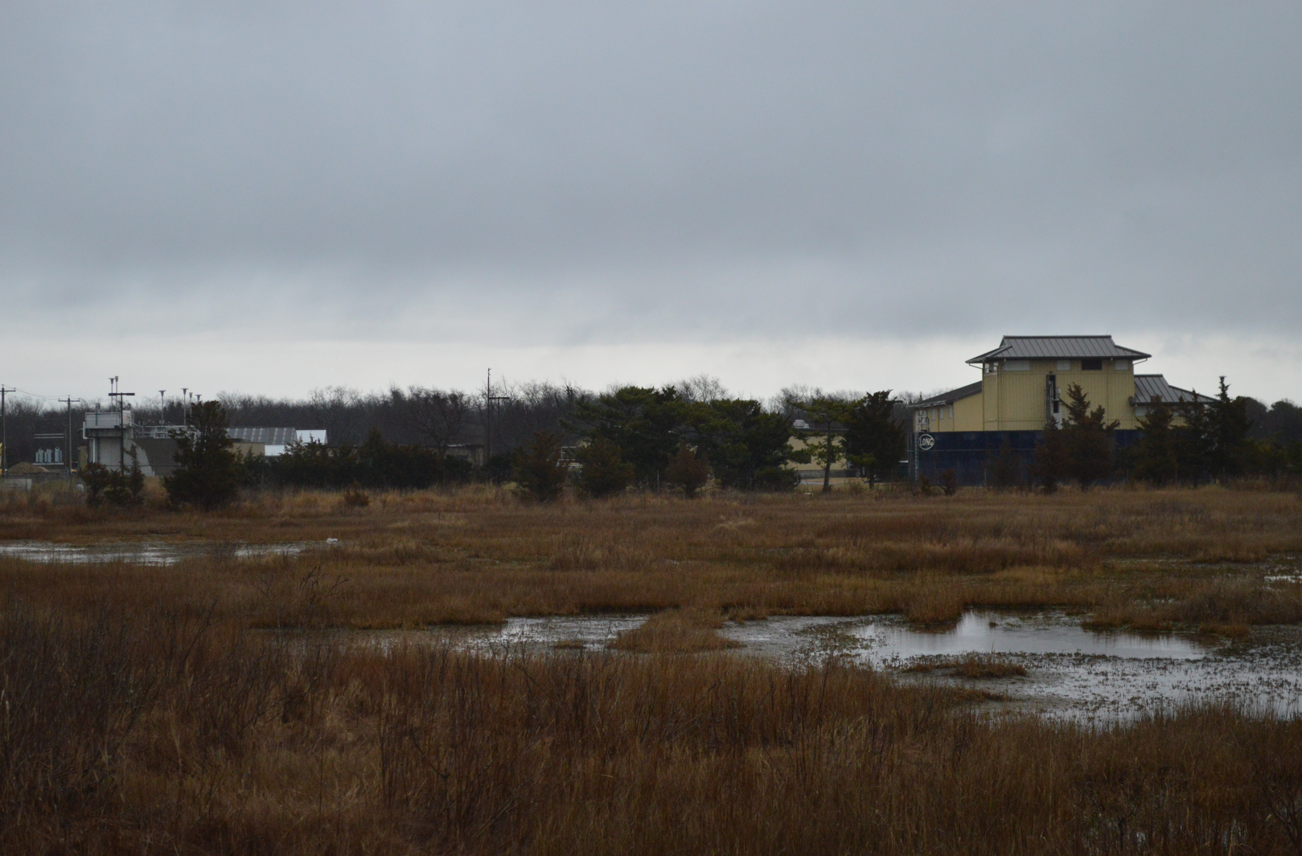
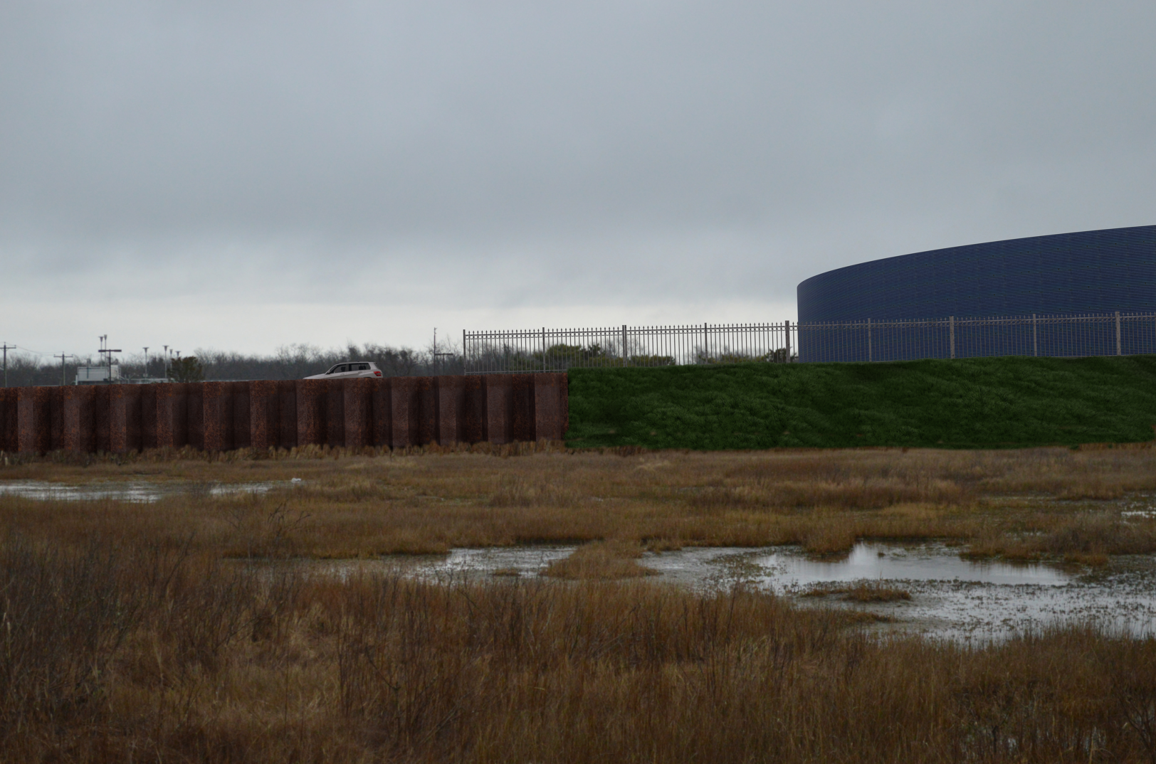
1. Option 1 Visualizations
View No. 2 – site perimeter viewed from E. Savannah Road
2
BEFORE
AFTER

Slide 7
1. Option 1 Visualizations
View No. 2 – site perimeter viewed from E. Savannah Road
2
NEW Site Fence
NEW 3.05 MG Flow Equalization Tank
NEW Perimeter flood barrier: sheet pile wall
NEW Perimeter flood barrier: compacted earth fill

Slide 8
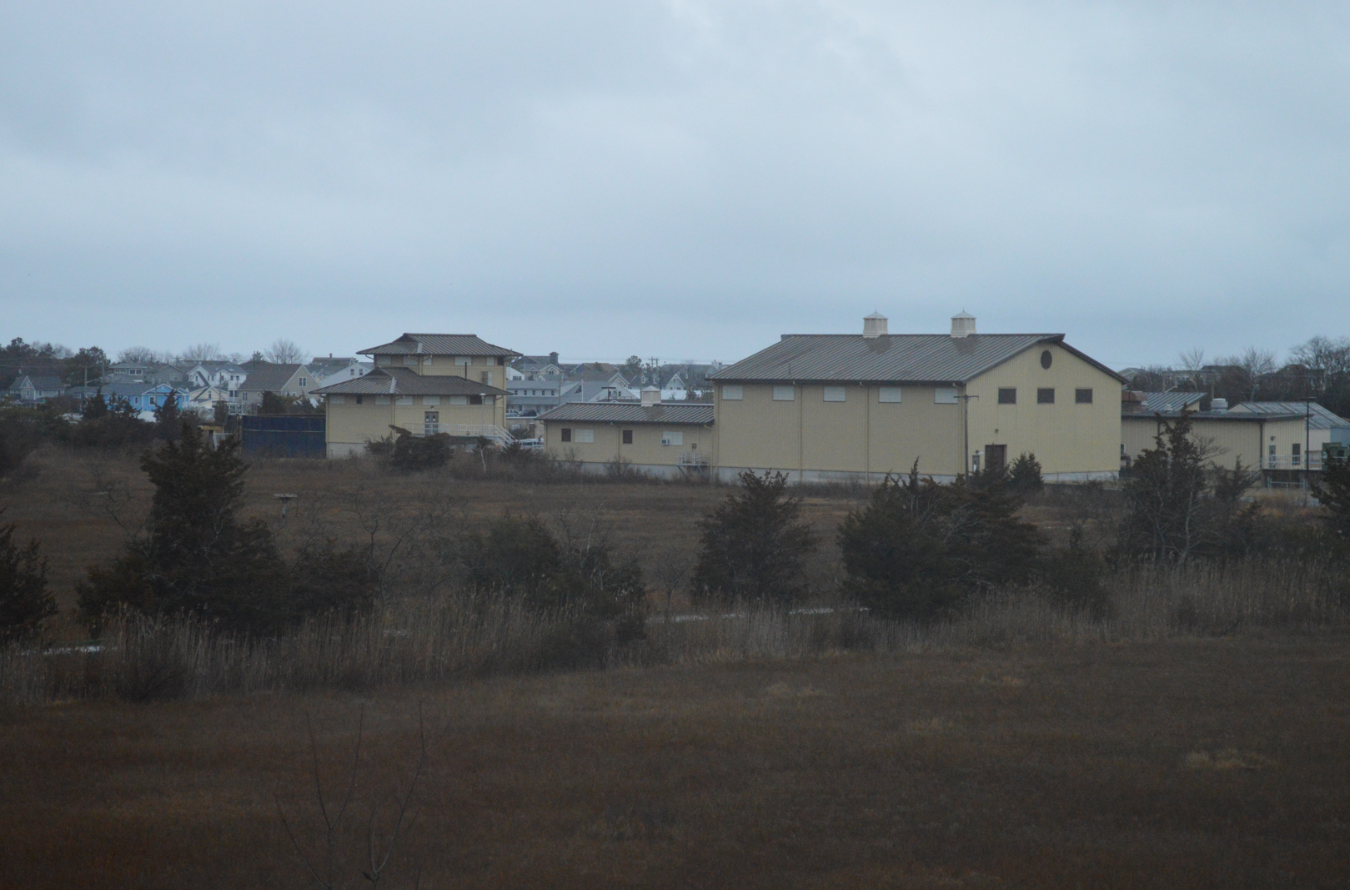
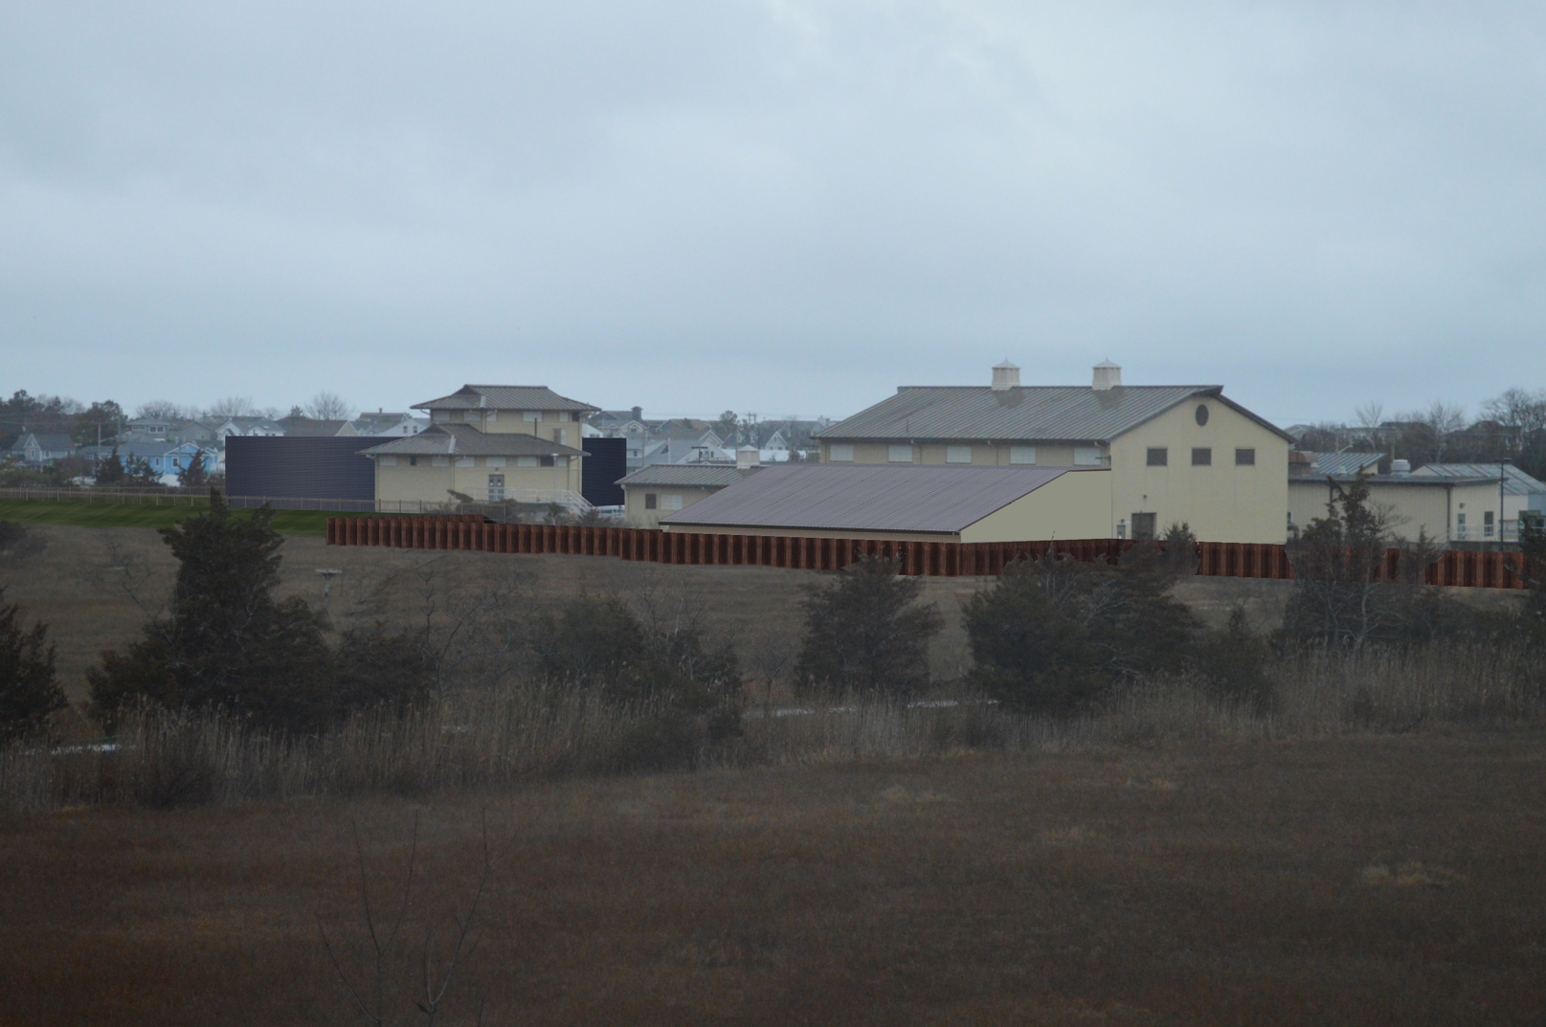
1. Option 1 Visualizations
View No. 3 – site perimeter viewed from Theo C. Freeman Memorial Highway (Rt. 9)
3
BEFORE
AFTER

Slide 9
1. Option 1 Visualizations
View No. 3 – site perimeter viewed from Theo C. Freeman Memorial Highway (Rt. 9)
3
NEW 3.05 MG Flow Equalization Tank
NEW Perimeter flood barrier: compacted earth fill
NEW Perimeter flood barrier: sheet pile wall
NEW MBR Building expansion

Slide 10
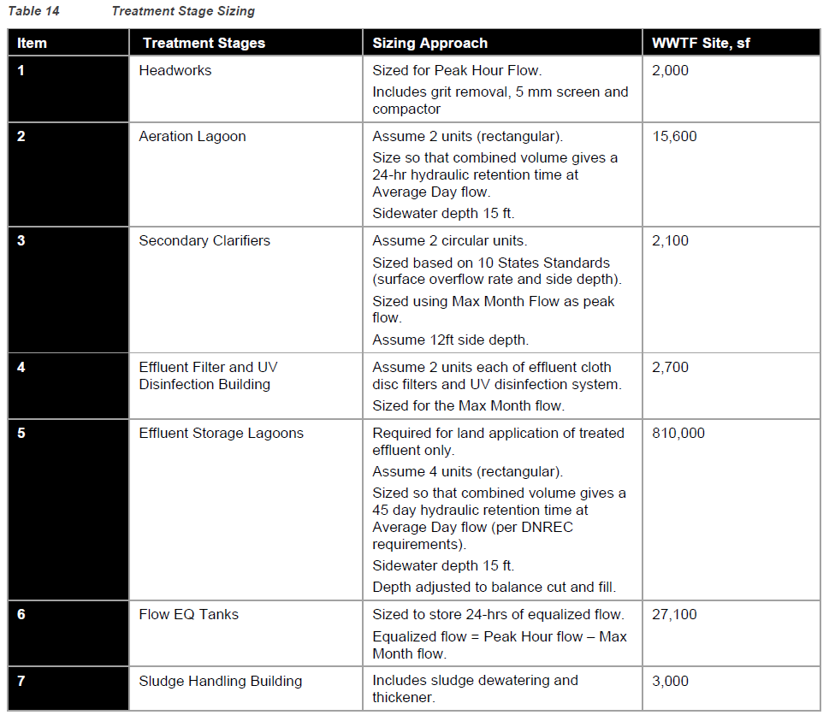
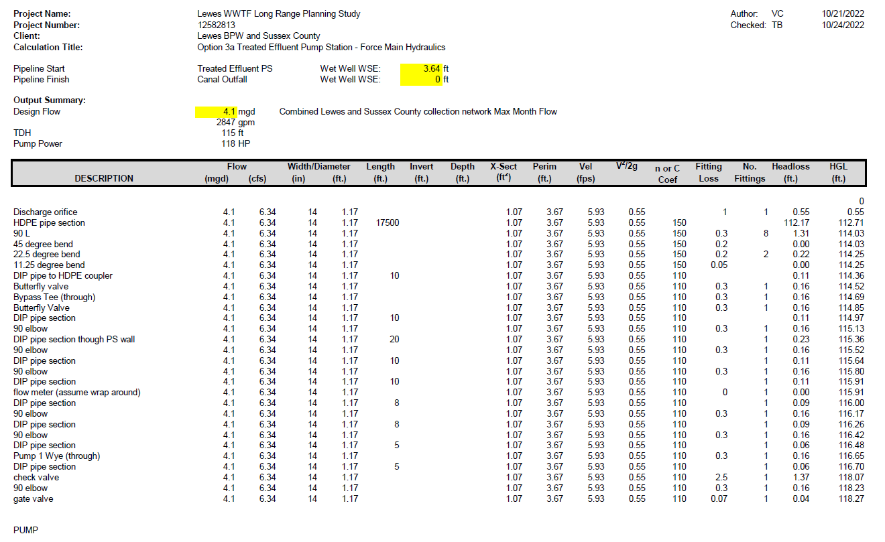
2. Cost Estimates
The approach used to develop the Preliminary Capital Cost Estimates was as follows
Engineering analysis and calculations
Establish key technical parameters for flood defenses, treatment equipment, storage tanks, pumping stations, pumps and pipelines using established industry standards and best practice
For detailed calculations and sizing assumptions refer to:
Option 1 Process Upgrades: Report Section 3.2.2
Option 1 Flood Defenses: Report Section 3.2.3
Option 2 Treatment Plant: Report Section 3.3.2
Option 2 Network Hydraulics: Report Section 3.3.3 and Appendix C
Option 3 Network Hydraulics: Report Section 3.4.4 and Appendix C
Physical Process Sizing and Land Use
Use the critical parameters identified in step 1 to develop physical dimensions for proposed upgrades
Estimate land areas required for Option 2 sites (including access roads, treatment facilities, treated effluent storage and treated effluent distribution)
Estimate land areas required for pumping station upgrades
Estimate pipeline lengths for flow transfers

Slide 11
2. Cost Estimates
Continued:
3. Estimate Base Costs for Construction, including:
Quantify extent of demolition work required
Estimate temporary facility requirements (excavation supports, groundwater pumping, traffic management, stormwater management facilities etc.)
Calculate earthworks quantities
Calculate pipeline diameters and trench dimensions
Calculate paving reinstatement required for existing public roads
Calculate concrete volumes for new structures
Estimate Architectural costs for new buildings (building superstructures, cladding and finishes, heating, ventilation and cooling)
Coordinate with equipment suppliers to specify and request quotes for major process equipment, including: flow transfer pumps, screens, grit removal, blowers, clarifier mechanisms, UV reactors, sludge dewatering equipment
General Contract Conditions and Electrical & Instrumentation works are estimated as a percentage of the itemized project costs. Percentage allocated are based on recent, observed market trends
4. Contingencies and Professional Services
35 % Construction Contingency; allows for funding risk associated with, for example: ground conditions, material cost fluctuations and contractor availability (among others)
20% Legal and Engineering costs; typical value observed for professional services on large capital projects
5% Administration costs; allows for Lewes BPW to administer and oversee the project delivery

Slide 12
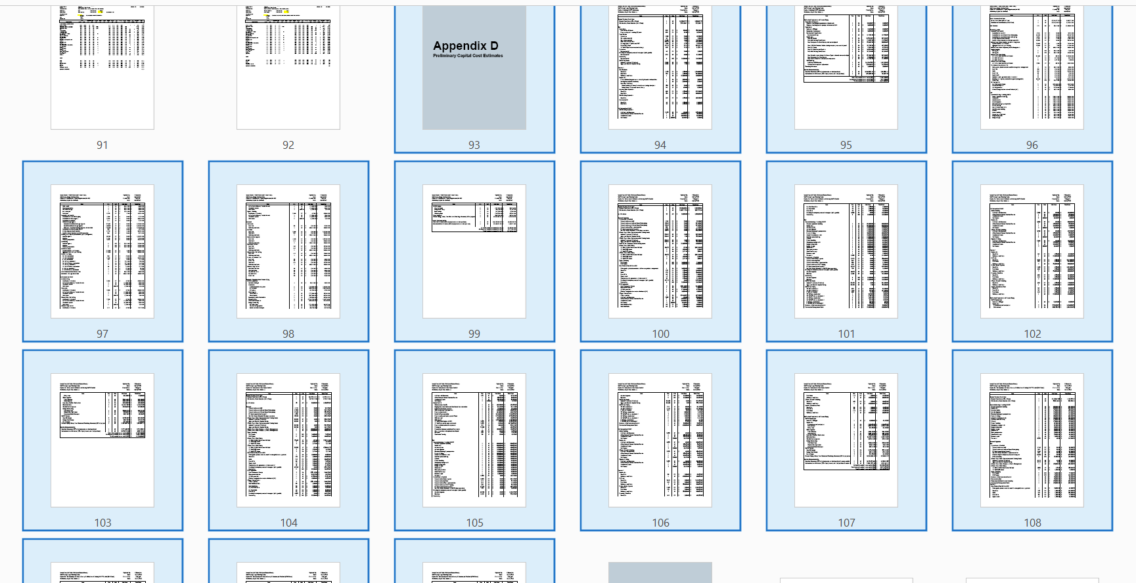
2. Cost Estimates
Itemized cost estimates – showing quantities and rates – are provided in Appendix D of the GHD report:

Slide 13
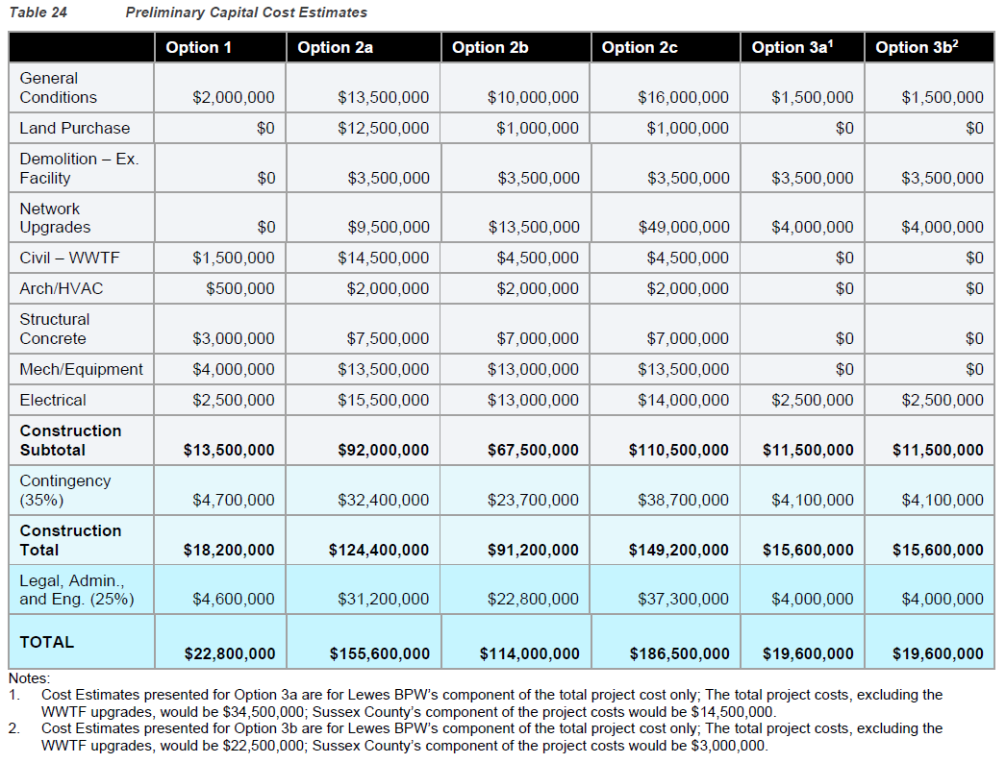
2. Cost Estimates
Some examples of key capital cost differentiators between differing options are provided in the upcoming slides:
1
2

Slide 14
2. Cost Estimates
Example Cost Differentiator # 1: Land Purchase
Option 1: Requires an increase in the WWTF site area of approx. 0.3 acres to accommodate new aerations basins and MBR building extension. Lewes BPW owns the land around the existing WWTF and therefore no additional land purchase is required for Option 1.
Option 2a: Entirely new plant requires a 250 acre site, including 230 acres for spray irrigation at an application rate of 2 inches per acres per 7 day period. Land purchase represents 13.6% of the Construction Subtotal for Option 2a.
Option 2b and 2c: Entirely new plant requires a 20 acre site. Treated effluent is discharged via canal or ocean outfall respectively and therefore spray irrigation area is not required. Land purchase represents 1.5% and 0.9% of the Construction Subtotals for Option 2b and Option 2c, respectively.
Option 3a and 3b: The new County WWTF would be constructed on land already owned by the County and would not require a capital cost contribution from Lewes BPW. Therefore, no additional land purchase is required for Option 3a or 3b.
1

Slide 15
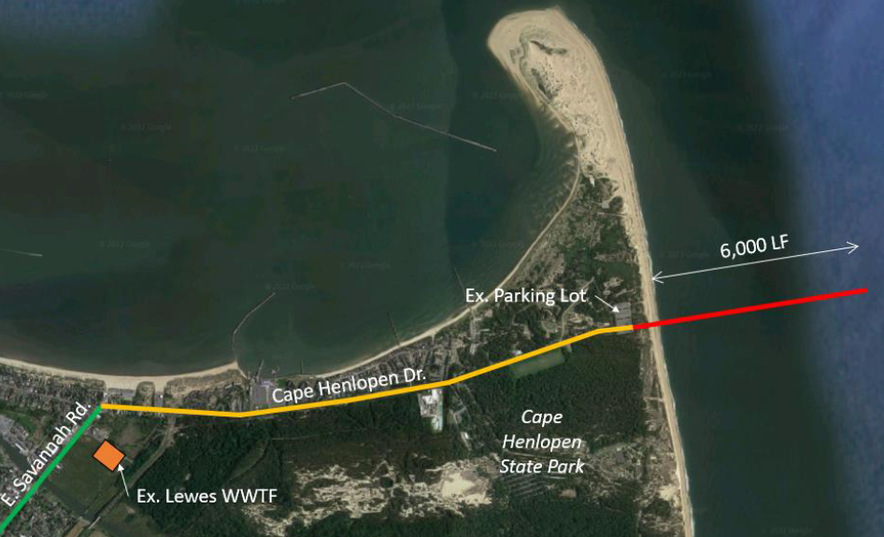
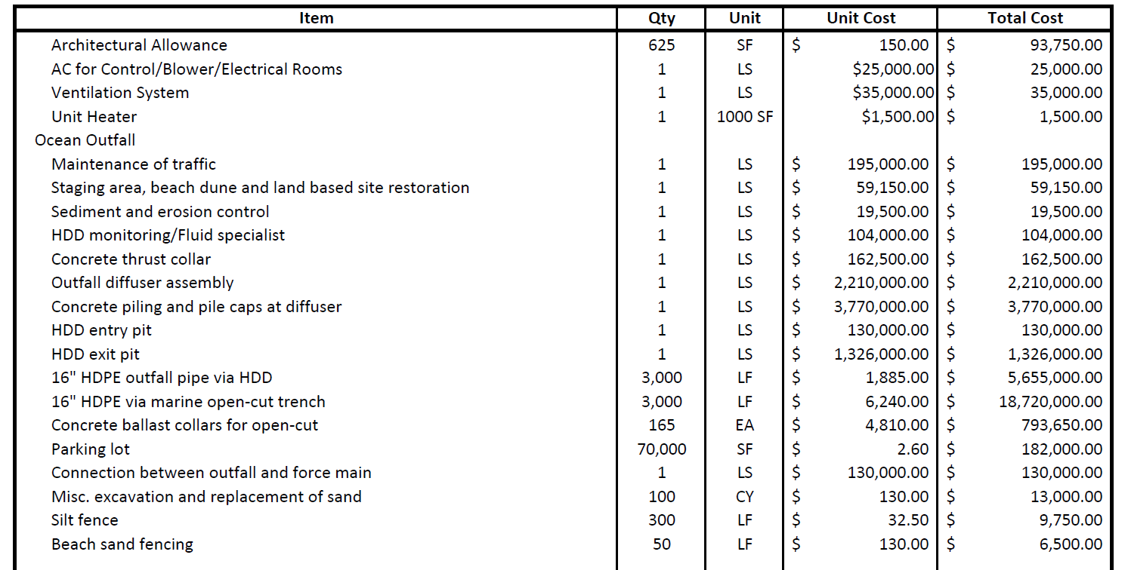
2. Cost Estimates
Example Cost Differentiator # 2: Network Upgrades
Option 1: existing lift stations will remain operational, therefore no additional network upgrades are required for Option 1.
Option 2a: a new raw wastewater pump station is required to transfer network flows to new WWTF site. Treated effluent is discharged via spray irrigation, close to the WWTF site. Network Upgrades represent 10.3 % of the Construction Subtotal for Option 2a.
Option 2b: a new raw wastewater pump station is required to transfer network flows to new WWTF site and a treated effluent pump station is required to transfer treated effluent back to the existing canal outfall. Network Upgrades represent 20.0 % of the Construction Subtotal for Option 2b.
Option 2c: a new raw wastewater pump station is required to transfer network flows to new WWTF site and a treated effluent pump station is required to transfer treated effluent to anew ocean outfall, which requires horizontal drilling and a section of marine open-cut trench. Network Upgrades represent 44.3 % of the Construction Subtotal for Option 2c.
Option 3a and 3b: BPW are only responsible for a new raw wastewater pump station and raw wastewater delivery main up to the existing BPW/ County scope boundary. Network Upgrades represent 34.8 % of the Construction Subtotal for Option 3a and 3b.
2

Slide 16
3. Water Quality Criteria
Permit Limit represents the expected performance of the existing WWTF at the rated capacity (1.5 mgd).
It corresponds to the design criteria for the WWTF.
Ex. Performance (Sep ‘20 to Sep ‘21) when Average Daily Flow was 0.89 mgd (60% capacity).
As flows increase towards the rated capacity, nutrient monthly average concentrations will trend towards permit limits due to reduced retention time in the aeration basins.
The future WWTF will meet all the conditions of the existing discharge permit.
In order to maintain the total waste loads within the existing permit limits at the 2050 Basis of Design flow rates, the new WWTFs will need to maintain TN and TP concentrations below the stated permit limits.
For Option 1 & 2 concepts, this will result in TN and TP concentrations higher than the existing performance data. However, the WWTF currently operates at only 60% of the rated capacity.

Slide 17
3. Water Quality Criteria
(1)
(2)
(3)
Example Calculation (1) – Existing Plant at Design Capacity, Treated Effluent Total Nitrogen Concentration:
[100 lbs per day Total Nitrogen] ÷ [1.5 million gallons per day treated flow] = 66.7 lbs Total Nitrogen per million gallons treated per day
Convert lbs/ MG to mg/L: divide by 8.34 = 8.0 mg/L Total Nitrogen
Example Calculation (2) – Option 1 & Option 2-a/b/c, Treated Effluent Total Nitrogen Concentration:
[100 lbs per day Total Nitrogen] ÷ [1.75 million gallons per day treated flow] = 57.1 lbs Total Nitrogen per million gallons treated per day
Convert lbs/ MG to mg/L: divide by 8.34 = 6.8 mg/L Total Nitrogen
Example Calculation (3) – Option 3-a/b, Treated Effluent Total Nitrogen Concentration:
[100 lbs per day Total Nitrogen] ÷ [3.50 million gallons per day treated flow] = 28.6 lbs Total Nitrogen per million gallons treated per day
Convert lbs/ MG to mg/L: divide by 8.34 = 3.4 mg/L Total Nitrogen
Waste loads – consistent for all options
Consistent waste load allocation, increasing flow rates → → → decreasing nutrient concentrations
(lowest for Option 3-a/b)
Flow Rate – varies between options

Slide 18
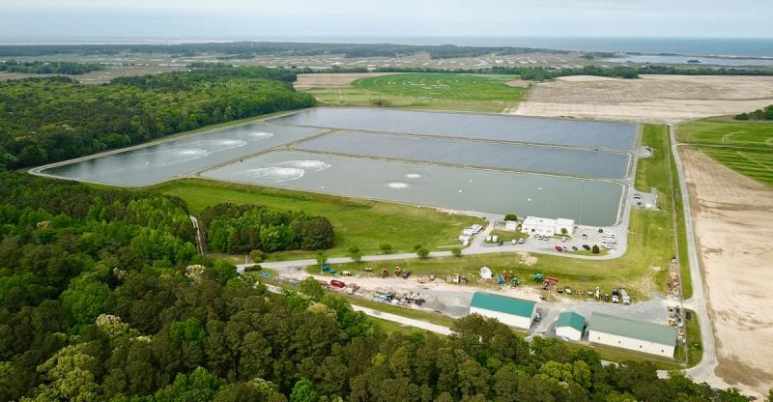
Tour of Wolfe Neck
Sussex County has graciously allowed for a tour of the Wolfe Neck Treatment Facility on Friday April 28th starting at 3:30pm. If you would like to attend, you must RSVP with the Lewes BPW. Attendance will be limited.
Photo taken by the Cape Gazette and Nick Roth

