Slide 1

Donovan Smith Mobile Home Park Sanitary Sewer and Water Extensions
Community Meeting
November 17, 2022
George, Miles & Buhr, LLC

Slide 2
Donovan Smith Mobile Home Park Sanitary Sewer and Water Extensions
OWNER: Lewes BPW
Represented by: Austin Calaman (General Manager)
Robin Davis (Ass’t. General Manager)
CONTRACTOR: Teal Construction, Inc.
Represented by: Johnny Stant
ENGINEER: George, Miles & Buhr, LLC
Represented by: Josh Elliott, P.E.
Vincent Luciani, P.E.
Charlie O’Donnell, P.E.
Duane Hoffman
CONTRACT TIME: 630 Calendar Days

Slide 3
Donovan Smith Mobile Home Park Sanitary Sewer and Water Extensions
Objectives of Project
    Replacement of the existing water mains with new PVC water main within Donovan Smith.
    Installation of new water services to each home and connection of water services to each home.
    Installation of new PVC sanitary sewer gravity mains in Donovan Smith.
    Installation of new sanitary sewer laterals to each home and connection of the laterals to each home.
    Abandonment of existing Sewer and Water.
    Rebuild all roads within Donovan Smith.

Slide 4
Donovan Smith Mobile Home Park Sanitary Sewer and Water Extensions
Anticipated Schedule
    The duration of the project is 630 calendar days. The tentative start date is mid February 2023, and the tentative completion date is mid November 2024.
    Progress meetings will occur monthly after construction begins.

Slide 5
Donovan Smith Mobile Home Park Sanitary Sewer and Water Extensions
Sequence of Construction
    Sewer main installation
    Water main installation
    Sewer and Water service connection to homes
    Abandonment of existing sewer and water
    Road rebuilding
    Restoration

Slide 6
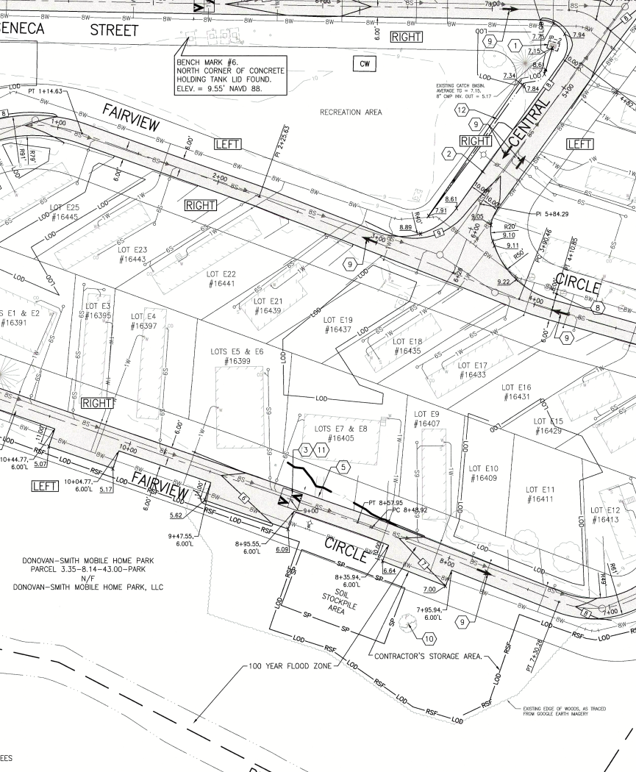
Staging Area/ Equipment Storage

Slide 7
Donovan Smith Mobile Home Park Sanitary Sewer and Water Extensions
Installation of Sanitary Sewer Gravity Main
    The existing sanitary sewer mains are a mix of old clay pipe and shallow-small diameter PVC pipe both which are prone to cracking.
    The proposed sanitary sewer mains will be large diameter PVC buried at the proper depth.
    The sewer main will require dewatering.

Slide 8
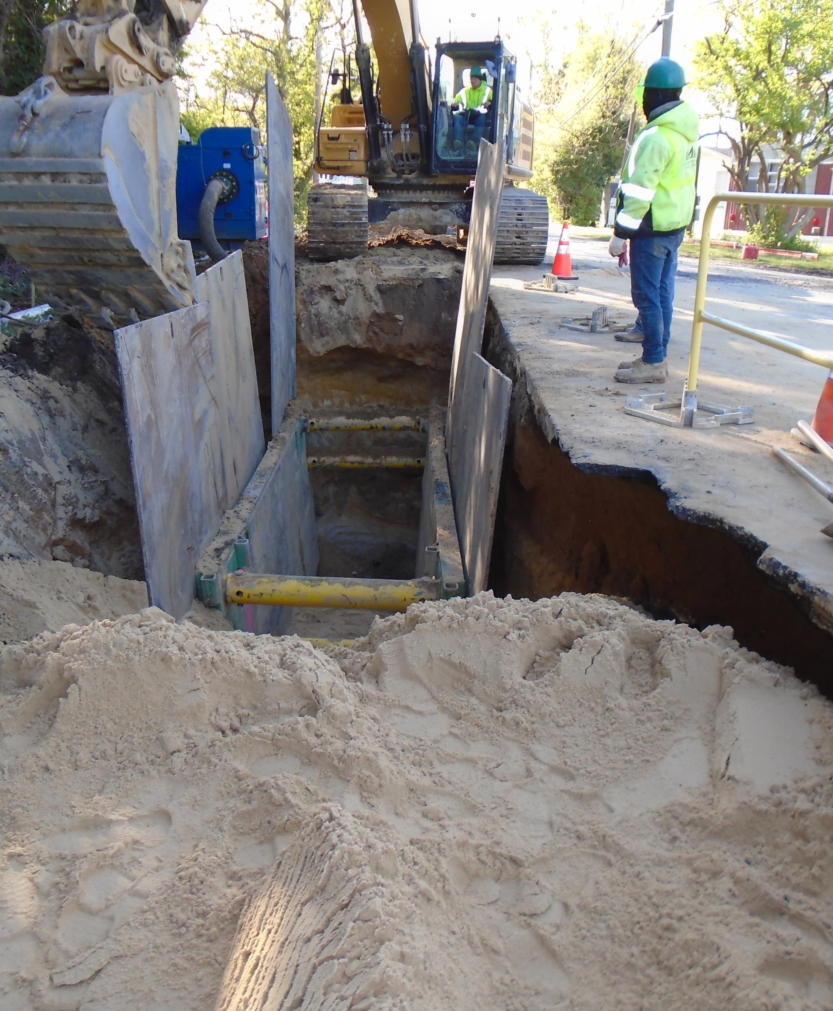
Sanitary Sewer Installation With a Trench Box

Slide 9
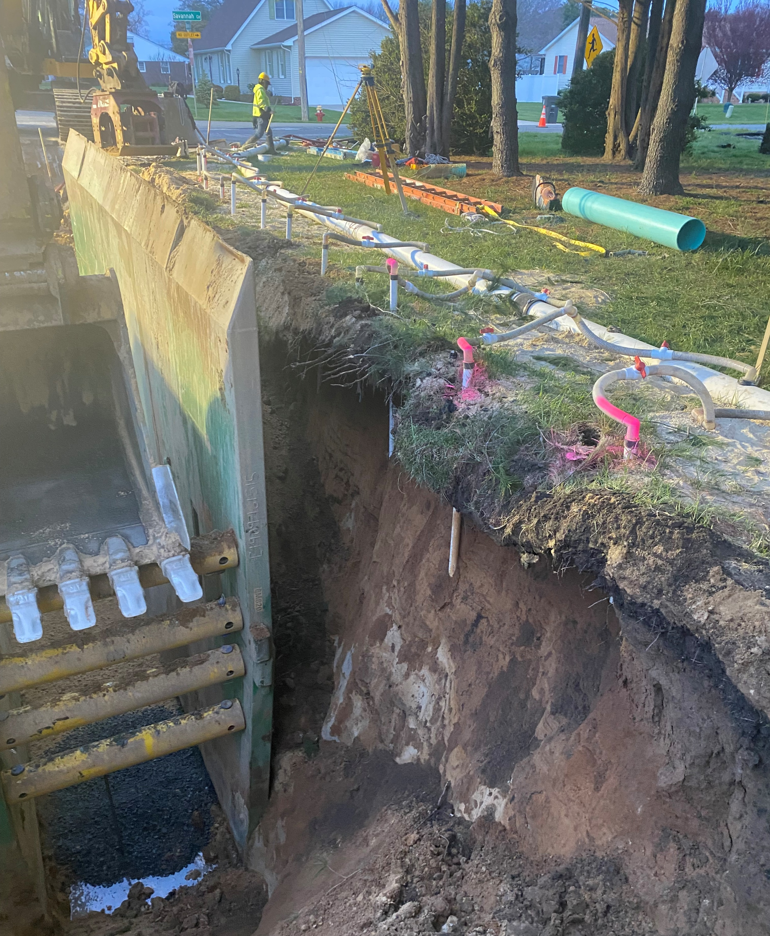
Dewatering System and Sanitary Sewer Trench

Slide 10
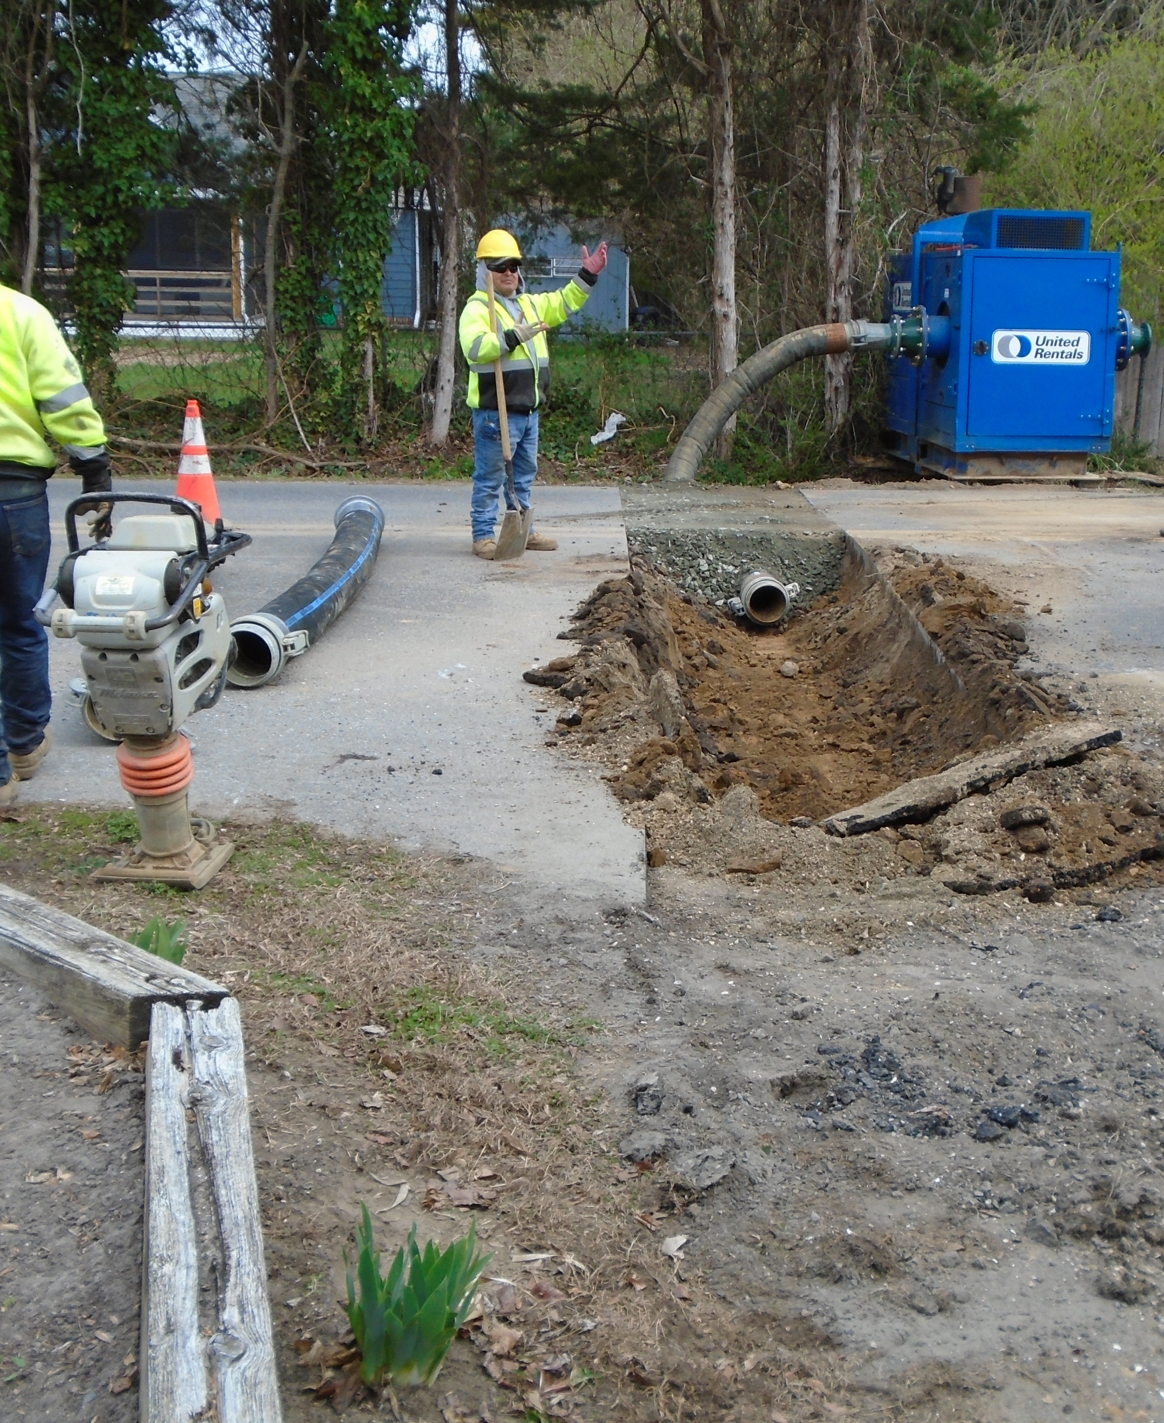
Dewatering Pump and Buried Dewatering Crossing

Slide 11
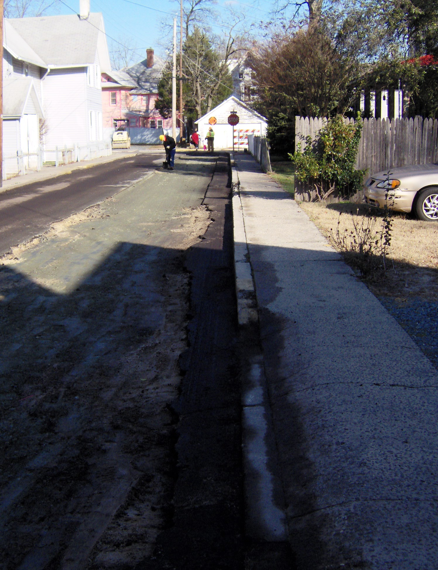
Daily Trench Restoration

Slide 12
Donovan Smith Mobile Home Park Sanitary Sewer and Water Extensions
Traffic Control During Construction
    Lane closures will be in place for work on two-way roads.
      Donovans Road will also have a lane closure to install the water main.
    Road Closures will be in place for work on one-way roads.
      Access to homes and emergency services will be maintained at all times.

Slide 13
Donovan Smith Mobile Home Park Sanitary Sewer and Water Extensions
Installation of Water Main
    Approximately 6,000 feet of new PVC water main will be installed within the Donovan Smith community.
    The existing water main that is fed by two community wells will be abandoned in place.

Slide 14
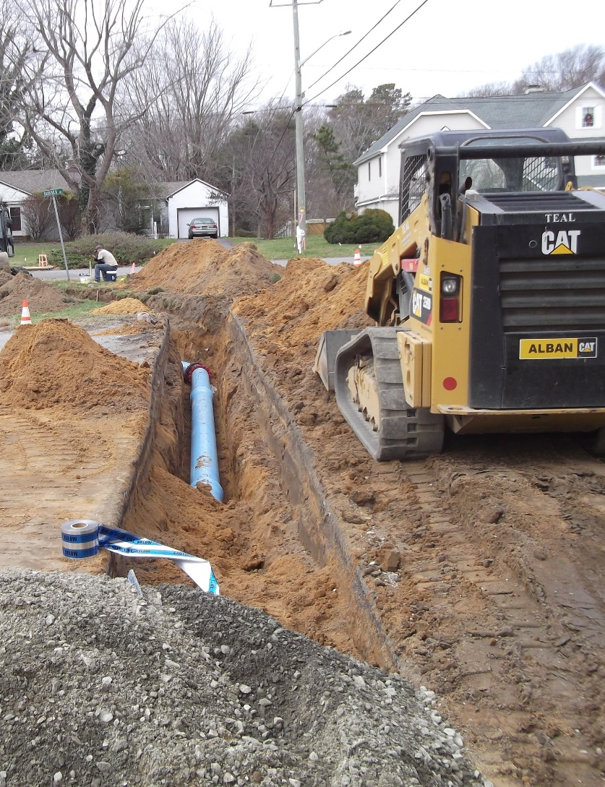
Donovan Smith Mobile Home Park Sanitary Sewer and Water Extensions

Slide 15
Donovan Smith Mobile Home Park Sanitary Sewer and Water Extensions
Installation of Sewer Laterals and Cleanouts
    Each lot will receive its own sewer connection.
    Sewer cleanouts will be installed at each sanitary sewer lateral.
    Additional cleanouts will be installed as necessary on each lot.
    Each home will experience a loss of service during the connection to the home. The loss will be approximately 1 hour.

Slide 16
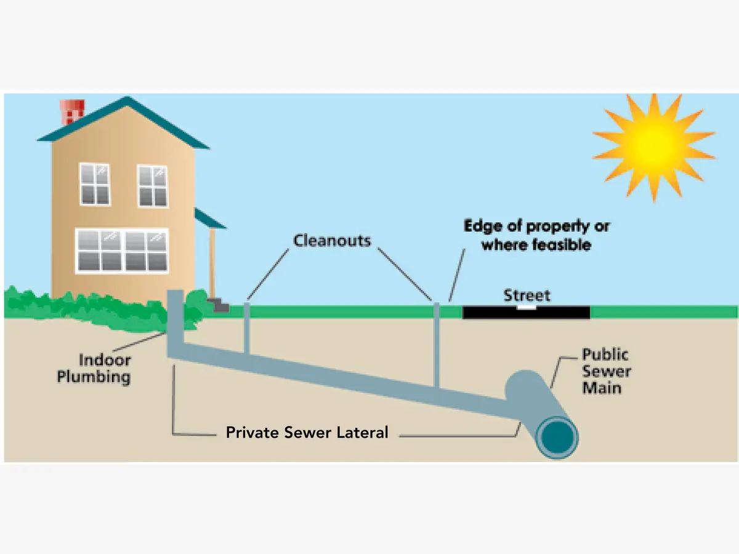
Donovan Smith Mobile Home Park Sanitary Sewer and Water Extensions

Slide 17
Donovan Smith Mobile Home Park Sanitary Sewer and Water Extensions
Installation of Water Services
    New water services will be installed at every property.
    Services will consist of a 1-inch diameter polyethylene plastic (PE) pipe, a curb stop, and a homeowner pit for winterizing.
    Services will be connected into existing house plumbing.
    Each home will experience a loss of service during the connection to the home. The loss will be approximately 1 hour.

Slide 18
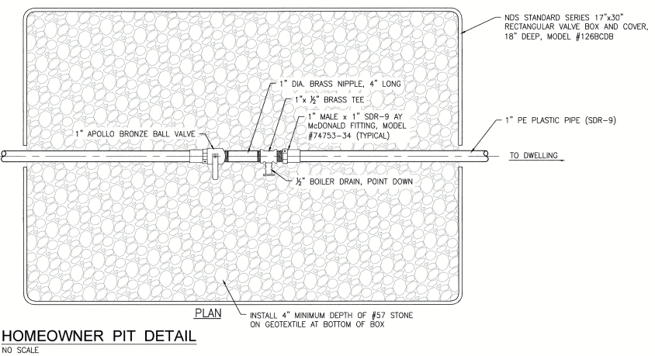
Donovan Smith Mobile Home Park Sanitary Sewer and Water Extensions

Slide 19
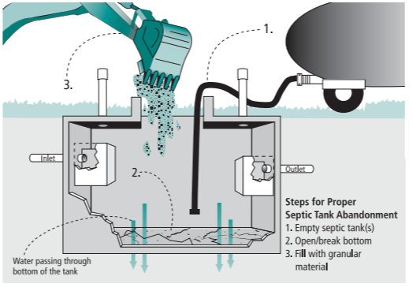
Donovan Smith Mobile Home Park Sanitary Sewer and Water Extensions
Abandonment of Septic Systems

Slide 20
Donovan Smith Mobile Home Park Sanitary Sewer and Water Extensions
Rebuild of Community Roads
    At the completion of all utility work, the roadway will be removed and rebuilt.
    The speed bumps will be replaced with speed humps.
    Signage will be added for the one-way roads.

Slide 21
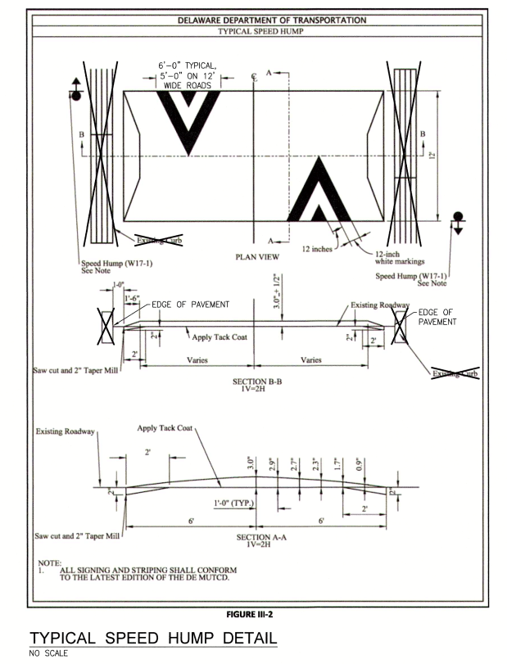
Donovan Smith Mobile Home Park Sanitary Sewer and Water Extensions

Slide 22
Donovan Smith Mobile Home Park Sanitary Sewer and Water Extensions
GMB Project Staff
    Duane Hoffman – (302) 519-3527 – dhoffman@gmbnet.com Duane will be GMB’s onsite Resident Project Representative (RPR) present onsite full-time for the duration of the work. All questions are to be directed to Duane during construction. We do not want direct communication with the contractor and the residents.
    Duane will be available to coordinate any work on homeowners lots (e.g., location of water services, sewer cleanouts, etc.).

Slide 23
Donovan Smith Mobile Home Park Sanitary Sewer and Water Extensions
Questions?

