Slide 1
Lewes BPW
NONPROFIT SERVICES
William H. Keetley III
Senior Vice President
Fulton Private Bank
302-633-7858 wkeetley@fultonbank.com
Theodore R. Walden, Jr.
Senior Vice President
Portfolio Manager
757-377-8796
twalden@fultonbank.com
Michael D. Wiggins
Vice President
Nonprofit Services
717-291-2554 mwiggins@fultonbank.com

Slide 2
Executive Summary
Forming long-term banking relationships
has always been the core of who we are.
At Fulton, we offer more than just loans and deposit accounts; we partner with you to provide advice and offer solutions to challenges that you and your organization face every day.
There is no shortage of banks for you to choose from; However, we feel Fulton Financial Advisors is best suited to be your financial partner.
HERE’S WHAT SETS US APART
RELATIONSHIP MANAGEMENT APPROACH
Your Relationship Manager takes time to get to know how your organization operates in order to provide relevant solutions to anticipated challenges.
FULL ARRAY OF SERVICES
We are large enough to offer a full array of financial services typically found only at larger financial institutions.
SPECIALIZED TEAM
Your Relationship Manager will help you assess your financial needs and connect you with experts from other areas of the bank.
LOCALIZED SUPPORT
Our client-friendly community banking model encourages easy access to localized decision making and quick responses to your questions.

Slide 3
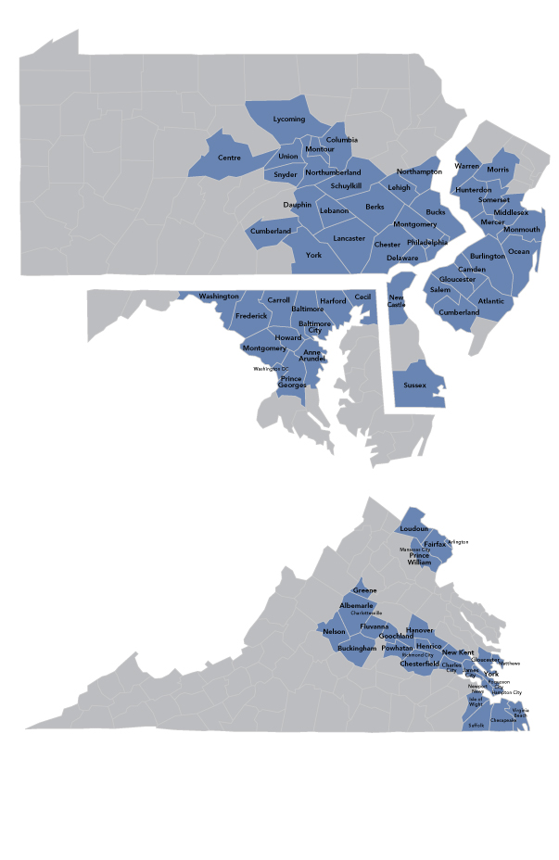
Fulton Financial Corporation
HISTORY
1882
1919
1982
Fulton National Bank founded
Trust department opened (July 10)
Fulton Financial Corporation (FFC) formed as a multi-bank holding company
ASSETS
$28 billion
HEADQUARTERS
Lancaster, Pennsylvania
OFFICES
3,200 employees | 200 banking offices | 5 states
DIVISIONS/SUBSIDIARIES
Fulton Private Bank | Fulton Financial Advisors Fulton Insurance Services Group | Fulton Mortgage Company
STOCK
Traded on NASDAQ under symbol FULT

Slide 4
Fulton Financial Advisors
Partnering with Foundations, Endowments, and other Charitable Organizations to help them reach their goals
227 Employees
5 States
$15 Billion
~40,000 Clients
Fulton Financial Advisors employs 227 people in 5 states and manages $15 billion for about 40,000 clients, including private foundations and other non-profit organizations, corporations, individuals, and government entities for Fulton Bank, N.A., an affiliate of Fulton Financial Corporation (FFC). FFC is located in Lancaster, PA and has over $28 billion in assets, employs 3,200 employees at 207 offices and trades on the Nasdaq under FULT. We are audited by internal and external auditors and are under OCC, SEC, and FDIC oversight.

Slide 5
Fulton Financial Advisors
Fulton Bank was founded in 1882
Fulton’s Trust Department was chartered in 1919.
Fulton manages finances and investments for municipalities (city, county and township), governmental entities, municipal authorities, nonprofits, including fire companies, school districts, corporations and individuals
Fulton’s Nonprofit Services group manages 250 relationships worth @ $1 billion
Fulton Financial Advisors manages $15 billion for @40,000 clients
Fulton manages
@ $350 Million for
@ 50 municipal entities throughout our footprint
Fulton’s Retirement Services Group
Manages @$160 million for municipal entity retirement plans.
EFFICIENT SERVICE DELIVERY • UNBIASED SOLUTIONS • COORDINATED EXECUTION • COST EFFECTIVE

Slide 6
Comprehensive Solutions for Nonprofits
Fulton Financial Advisors provides nonprofit organizations with customized, unbiased solutions in the areas of Investment Management, Endowment Governance and Planned Giving.
Our experienced, credentialed staff is capable of providing guidance for the unique challenges faced by the non-profit sector. We are big enough to provide these specialized solutions, and small enough to deliver high touch service.
ENDOWMENT GOVERNANCE
Risk Profile Assessment
Asset Allocation Strategy
Spending Policy
Investment Policy Statement
INVESTMENT SOLUTIONS
Disciplined & Clear Investment Process
Investment Solutions without Fee Bias
Risk Mitigation
Custodial Services
PLANNED GIVING SUPPORT
Charitable Gift Annuity Administration
Speakers for Donor Seminars
On-Line Planned Giving Software
Planned Giving Advice
EXPERIENCED STAFF INCLUDING FFC LENDERS
Solutions for Unique Problems
An Advisory Approach
Partnering with our Lenders for 360 Degree Solutions
EFFICIENT SERVICE DELIVERY • UNBIASED SOLUTIONS • COORDINATED EXECUTION • COST EFFECTIVE

Slide 7
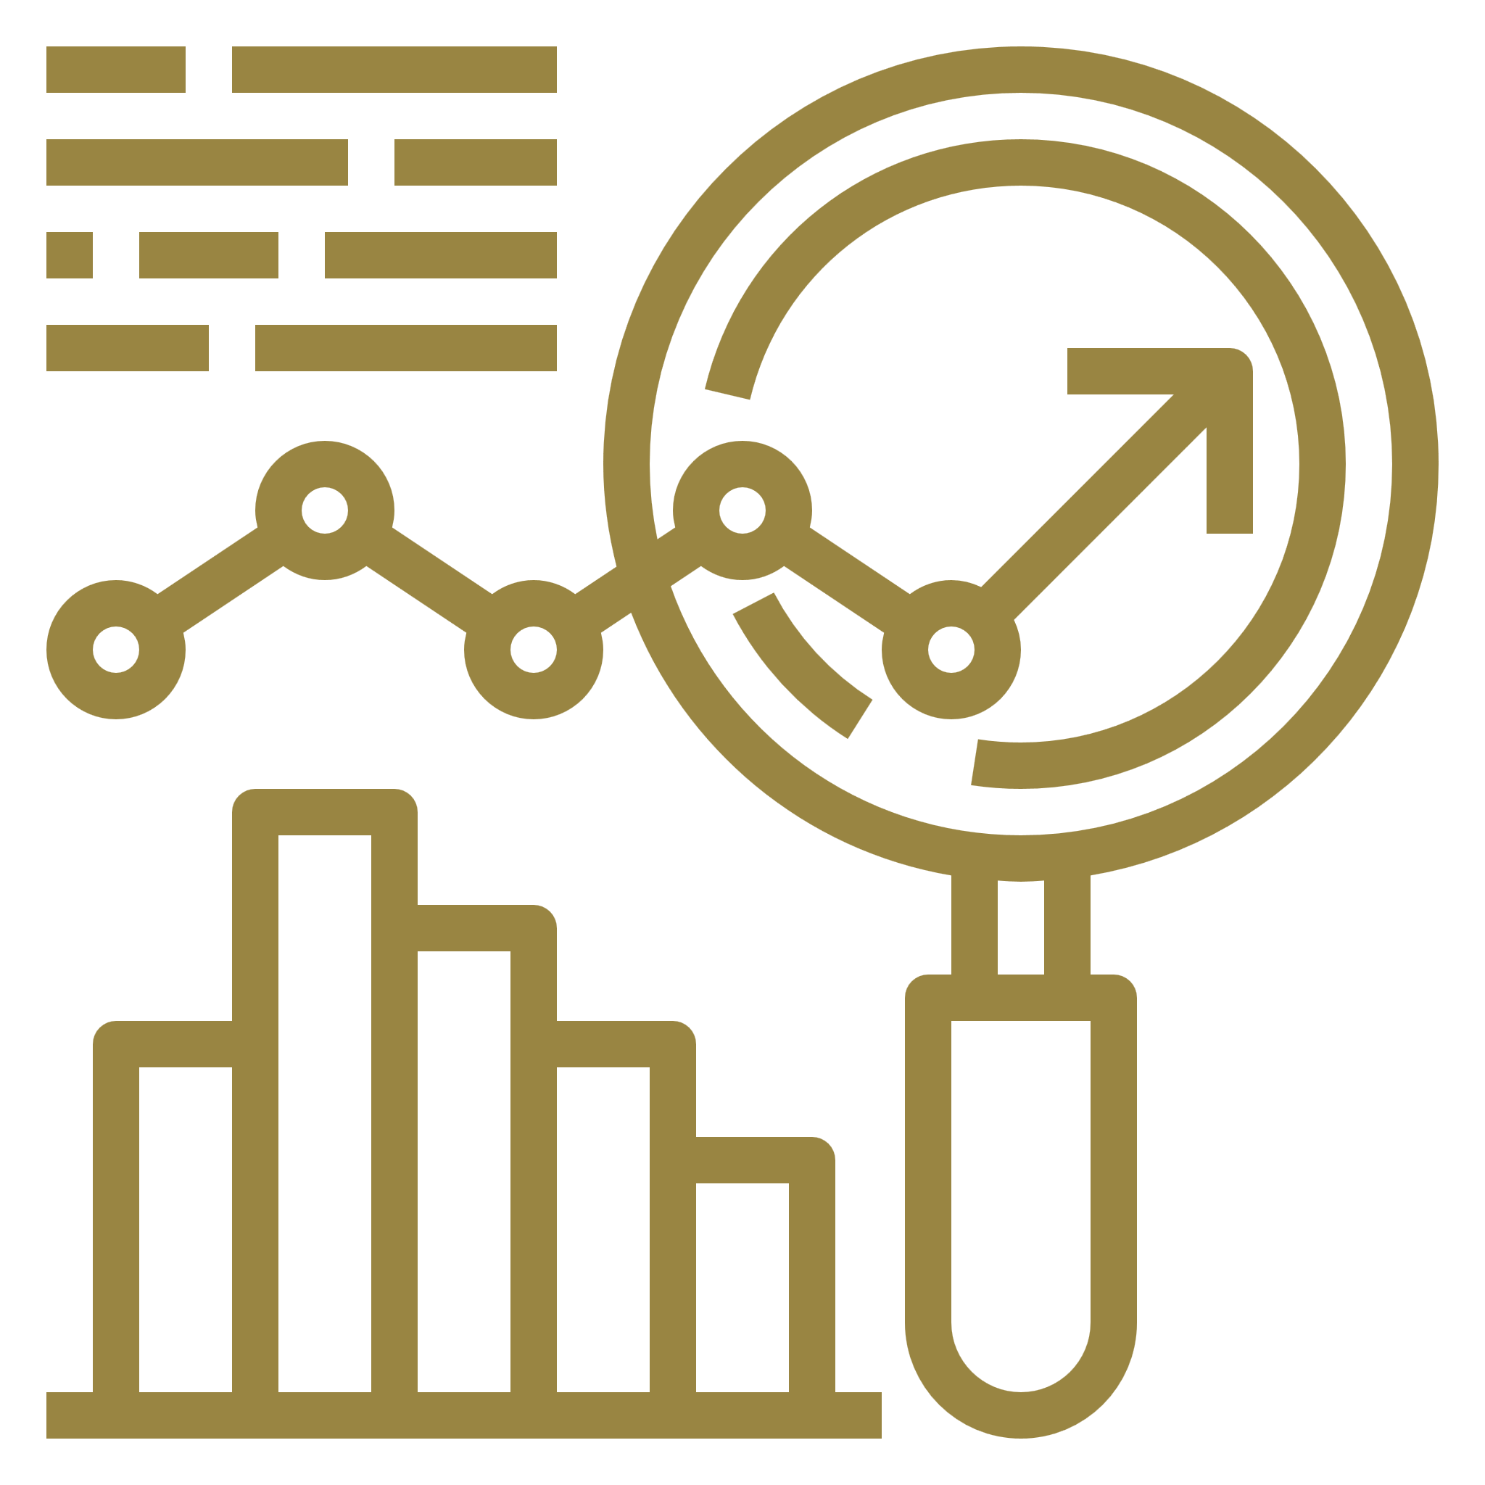
Fiduciary Expertise
The safest standards and principles for nonprofits
Like your Board of Trustees, Fulton Financial Advisors will exercise its fiduciary duty to always act for the good of the organization and exercise reasonable care in all decision making, without placing the organization under unnecessary risk with regard to the investment management services provided.
Fulton Financial Advisors is held to the highest fiduciary standard by the Office of the Comptroller of the Currency providing greater oversight than only Securities and Exchange Commission oversight.
WE WILL HELP YOU MEET YOUR CORPORATE AND FIDUCIARY RESPONSIBILITIES BY:
Establishing or reviewing an investment policy statement which documents all pertinent client investment goals and objectives and outlines investment rules for the manager
Recommending appropriate asset allocation levels and minimum and maximum ranges around them
Recommending reasonable return targets and acceptable levels of risk relative to your objective
Evaluating and selecting appropriate investment categories, investment managers and benchmarks
Monitoring investments over time and reporting to your Committee

Slide 8
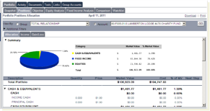
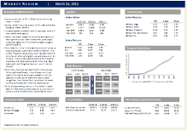
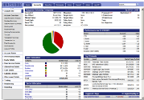
Relationship Management
Our Service and Communications Commitment
DEDICATED CONTACT
You’re serviced by a dedicated and experienced point of contact – familiar with all aspects of your situation and the needs of the organization, such as
Specialized one-on-one meetings with staff & board as needed
Processing of gifts of stock
Advice & assistance with spending policy guidelines & calculations
TENURED AND CREDENTIALED TEAM
Your contact is supported by a highly experienced and credentialed team in all aspects of investment management and charitable endowments.
CUSTODY SERVICES
We provide custody services of all portfolio assets and timely collection of income and trade settlement allowing for seamless, integrated and automated servicing of your account.
EASY ACCESS TO INFORMATION
We conduct and attend regular status meetings and provide online account access, market insights, and publications.
MONTHLY ACCOUNTINGS
We render monthly accountings that disclose all investment transactions and cash transactions affecting portfolio assets.
PLANNED GIVING
We can support your organization in attracting donors and help to establish a charitable gift annuity program if desired. We handle all tax reporting and distributions to donors – saving you time.
STATUS MEETINGS
Regular meetings to discuss investment strategy, changes in circumstances, and progress toward goals.
ONLINE ACCOUNT ACCESS
24/7 access to online portfolio of account information.
MARKET INSIGHTS
Timely economic and market strategy information delivered electronically.
PUBLICATIONS
Comprehensive investment reports that detail all activity and portfolio performance to keep you informed of progress toward goals.

Slide 9
Nonprofit Services Team
FFA Chief Executive Officer
David B. Hanson, CPA, CFA¹
Chief Investment Officer
Keith P. Aleardi, MS, CFA^{1, 2}
Nonprofit Services
Sheri A. Leo, AIF – Manager
Francis V. Clementi
Lori J. Jones
Samantha L. Kemmler
Peter D. Reitmeyer, CAP
Joann Stepanski
Michael D. Wiggins, MBA
Portfolio Management
Walter J. Banta, APMA ²
Matthew T. Brennan, CFA ^{1, 2}
Matthew D. Bush
Richard J. Diem, CFA
Bruce D. Eden, MBA ²
Kyle M. Ireland
Andrew T. Mesick ¹
George W. Nichols, MBA ^{1, 2}
Elizabeth A. Peris, CFA ²
Mary Talbutt-Margerum
Jeffery R. Taylor, CFA, CFS
Theodore R. Walden. AIF
Investment Strategy Committee
Investment Policy Committee
Tax officers
Michelle S. Long, MS, EA, Manager, Tax Group
Fred S.Bachman
Lisa Bierlein, CESP
Susan Wisniewski
Chief Fiduciary Officer
Kristen L. Hartman, J.D., LLM

Slide 10
Fee Proposal
Fulton
Advisory fee
0.50%
West Goshen Township
Relationship
$
23
$
10
million
million
FFA Fee Schedule:
On the first $1 Million | 0.95%
On the next $2 Million | 0.60%
On the next $2 Million | 0.45%
Balance over $5 Million | 0.40%
Fulton will guarantee the proposed fee for a minimum of two years from date of account funding.

Slide 11
Overall Relationship Pricing Model
Current Fee Model & Structure
Lewes Nationwide 457 Plan $21,494
Lewes Nationwide DB Plan $24,168
UBS Corp Asset Mgmt acct @$107,400 *
* Assuming 93 BPS fee based on Q4 2021 account values as reflected in fees charged in Q1 2022’
Total Current Advisor Fees @ $153,062
Fulton Fee Model & Structure
Fulton 457 Plan $13,971
Fulton DB Plan $17,477
Fulton Corp Asset Mgmt acct @$50,000
Assuming 50 BPS fee on an average account value of $10,000,000
Total New Advisor Fees @ $81,448
Total expense savings of @ $71,614

Slide 12
Disciplined Investment Philosophy
Unbiased Investment Management
Consistent performance and risk management are best attained through global diversification of equity and fixed income holdings, the use of real assets and alternative investments
A diversified investment set enhances the potential for better risk adjusted performance over a full market cycle
Asset classes are selected for portfolio inclusion using internal and external resources. Each asset class is selected based on its’ opportunity for investment return, with consideration given to risks statistics, political concerns, historical performance and correlation to other asset classes
Both asset allocation and manager selection are used to control the risk and return characteristics of each portfolio
Strategic asset allocation coupled with dynamic rebalancing based on changing market conditions provides the appropriate blend of discipline and opportunity
Strategic target weights are optimized by the risk/reward profile for each individual asset class/category
Capital market research guides both inter- and intra-asset class weightings
Dynamic rebalancing occurs based on ongoing evaluations of the market environment, opportunities, and potential risks
Rigorous due diligence of specialist investment managers offers the best potential for risk adjusted investment reward
An unbiased, open architecture approach to manager selection of SMAs, UMAs, Mutual Funds, and ETFs
Rigorous search, selection, and ongoing due diligence of investment managers
Full transparency is required for manager addition to our buy list
Validation through Auditors, Regulators and Industry Consultants
Verify controls in place to mitigate process risks
Ensures fiduciary process is intact
Robust oversight to provide best outcomes for client

Slide 13
Investment Management
Comprehensive and Flexible
Index Aware Active
Traditional Active Fixed Income
Traditional Active Equity
UnconstrainedActive
Alternatives
Concentrated High Conviction Equity
PASSIVE
Index Equity
Index Fixed Income
Money Market
EXPENSES
Tax-Exempt
Taxable
Tax Sensitive
FACTOR-BASED
Smart Beta
Quantitative Active Equity
Passive Investment Management
We incorporate passive management for indexing and investment-grade fixed income strategies:
Active Investment Management
We favor active management in traditional active equity, fixed income, and alternative strategies:
No opportunity for alpha generations
Costs are key to performance
Provide cost-effective exposure to efficient markets
Opportunity for manager alpha generations
Costs matter, but manager skill is critical
Advantaged by inefficient markets

Slide 14
Investment Manager Selection
Due Diligence & Oversight
Subtractive Process
Proprietary quantitative screening of manager databases (25,897 funds and 9,488 SMAs)
Quantitative factors – peer group relative performance and risk metrics, cost, assets, manager tenure
Industry contacts and manager visits
Investment strategy vehicle structure and access
OVERALL VIEWED UNIVERSE
Equity: 17,097
Fixed Income: 8,757
Diversifiers: 1,713
Manager Due Diligence
The people, philosophy, and processes behind the numbers
Potential repeatability of investment process over time
Seeks consistency of performance through changing market environments
Depth of team, longevity at firm, team cohesiveness
MANAGERS ON THE PLATFORM
Equity: 320
Fixed Income: 95
Diversifiers: 58
Approved Managers
APPROVED MANAGERS SELECTED
Equity: 198
Fixed Income: 90
Diversifiers: 29
198 Equity Strategies
90 Fixed Income Strategies
29 Diversifier Strategies
Manager Oversight
Selected Managers reviewed quarterly
Site visits conducted every 18 months
Performance update – quarterly review against peer and benchmarks
Personnel/Firm updates – any changes to the firm (e.g. large asset changes, personnel changes, new products)

Slide 15
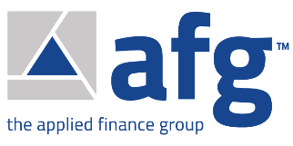
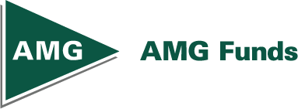
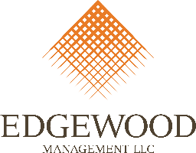
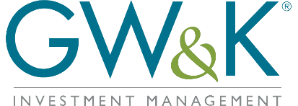
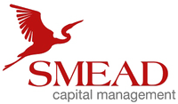
Asset Managers
World Class Alliances, One Coordinated Relationship

Slide 16
Why Fulton Financial Advisors
Large Regional Financial Institution with Significant Resources
Comprehensive Delivery Approach
Local Community Commitment
Disciplined and Unbiased Investment Management
Dedicated Non-Profit, Charities and Endowment Group
Superior Risk Adjusted Investment Results
Experienced and Credentialed Relationship Team
Cost Effective Fee-Only Provider
Planned Giving Expertise and Support
Fiduciary Protection & Expertise

Slide 17
Disclosure
Fulton Financial Advisors operates through Fulton Bank, N.A. and other subsidiaries of Fulton Financial Corporation.
The information and material in this report is being provided for informational purposes only, and is not intended as an offer or solicitation for the purchase or sale of any financial instrument or to adopt a particular investment strategy.
Information has been obtained from sources believed to be reliable but Fulton Financial Advisors or its affiliates and/or subsidiaries (collectively “Fulton”) do not warrant its completeness, timeliness or accuracy, except with respect to any disclosures relative to Fulton.
The information contained herein is as of the date referenced above, and Fulton does not undertake any obligation to update such information. Fulton affiliates may issue reports or have opinions that are inconsistent with, or reach different conclusions from, this report.
All charts and graphs are shown for illustrative purposes only. Opinions, estimates, forecasts, and statements of financial market trends that are based on current market conditions constitute our judgment and are subject to change without notice.
Any opinions and recommendations expressed herein do not take into account an investor's financial circumstances, investment objectives or financial needs, and are not intended as advice regarding or recommendations of particular investments and/or trading strategies, including investments that reference a particular derivative index or other benchmark.
The investments described herein may be complex, involve significant risk and volatility, and may only be appropriate for highly sophisticated investors who are capable of understanding and assuming the risks involved. The investments discussed may fluctuate in price or value and could be adversely affected by changes in interest rates, exchange rates or other factors.
Past performance is not indicative of future results. The value or income associated with a security may fluctuate, and investors could lose their entire investment. Asset allocation and diversification do not assure or guarantee better performance and cannot eliminate the risk of investment losses.
Investors must make their own decisions regarding any securities or financial instruments mentioned herein and must not rely upon this report in evaluating the merits of investing in any instruments or pursuing investment strategies described herein. You should consult with your own advisors as to the suitability of such securities or other financial instruments for your particular circumstances. In no event shall Fulton be liable for any use by any party of, for any decision made or action taken by any party in reliance upon, or for any inaccuracies or errors in, or omissions from, the information contained herein.
Investments and insurance products recommended or sold by Fulton are not deposits or other obligations of any insured depository institution, including Fulton Bank, N.A., and are not insured by the FDIC, the Federal Reserve Board, or any other state or federal governmental agency.
Fulton makes no representations as to the legal, tax, credit, or accounting treatment of any transactions or strategies mentioned herein, or any other effects such transactions may have on investors. You should review any planned financial transactions that may have tax or legal implications with a tax or legal advisor.
Recipients of this report will not be treated as customers of Fulton by virtue of having received this report. No part of this report may be redistributed to others or replicated in any form without prior consent of Fulton.

