Slide 1
Wastewater Facilities Long-Range Planning

Slide 2
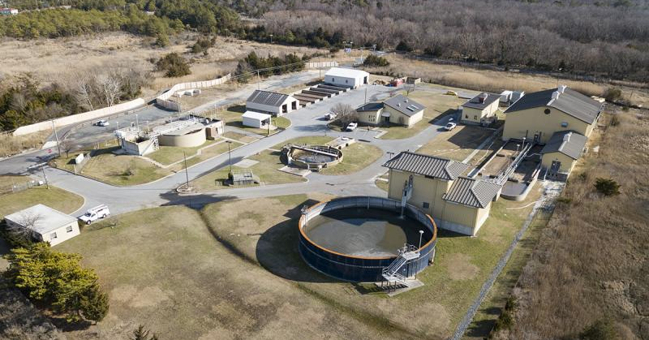
Existing Howard Seymour Water Reclamation Facility
Cape Gazette- NICK ROTH PHOTO

Slide 3
Purpose of this Workshop
The purpose of this workshop is to solicit public input on a very important decision the Board of Directors must make regarding the future of the BPW’s wastewater facilities. As will be discussed, it not only involves major financial and environmental considerations, but it also contains sensitive civic considerations.
At this point this is an unexplored concept. No detailed planning or design has been authorized and no agreements have been reached. We therefore do not have detailed cost estimates, only order of magnitude estimates, and will not be able to provide answers to all your questions.
If possible, we would like to leave here with an indication whether we should continue evaluating all concepts or remove any from further consideration.

Slide 4
Background
The Board of Directors of the Lewes BPW have authorized the staff to prepare a grant application for submission to DNREC for long-range planning needs.
This would be a holistic study looking at options including but not limited to:
“Hardening” the existing Howard Seymour Water Reclamation Facility
Construction of a plant at a new location
Sending BPW’s wastewater to Sussex County for Treatment

Slide 5
“Hardening” of Existing Plant
The hardening of the existing plant could be done by using dikes, levees, watertight containments, elevating critical equipment, etc.…, against sea level rise/climate change.
Improvements of facilities and equipment for access to the site during major storm events.
This would keep the plant where it is and utilize the existing outfall pipe.
Very rough estimate would be $20 mil.

Slide 6
Build Plant at New Location
Building a plant at a different location that would be less susceptible to sea level rise/climate change. ($30mil.)
Land acquisition would be very difficult and very costly. (Possibly 10 acres at $0.55 mil./ac. or $5.5 mil.)
Total rough estimate for new plant - $35.5 mil. plus treated wastewater disposal options.

Slide 7
Treated Wastewater Disposal Options from New Plant
If the present outfall pipe is used, additional pumping facilities and piping is needed. ($12.0 mil. assuming 10 miles at $1.2 mil./mi.) Total including treatment plant $47.5 mil.
An ocean outfall like Rehoboth would be difficult and very expensive. ($52.5 mil.) Total including treatment plant $88.0 mil.
Land application of the effluent would require approximately 300 +acres of land and which would be difficult to find and very expensive. ($30 mil. for land plus; $12.0 mil. assuming 10 mi. of piping; $42 mil. total) Total including treatment plant $ 77.5 mil.

Slide 8
Sending BPW’s Wastewater to Sussex County for Treatment
All BPW’s wastewater would be pumped to the county’s Wolfe Neck Plant.
County would upgrade their plant and provide necessary treatment.
The treated water would be returned to Lewes for disposal at the BPW’s existing outfall.
The BPW’s existing plant would be demolished and made available for other purposes.

Slide 9
Coordination With the Sussex County Engineering Department
Sussex County would be responsible for the costs of:
The upgrades to their treatment facility.
The necessary piping between the County’s plant and the BPW’s facilities.
The BPW would be responsible for:
The decommissioning and demolition of the existing plant ($3.0 mil.)
Necessary upgrades to the two major pumping stations (PS. #4 and PS. #8; $3.0 mil.)
Total project cost $6.0 mil.

Slide 10
Environmental Considerations
Design Flow for the County’s upgraded plant would be 3.0 MGD
2.75 MGD pumped to the BPW’s present outfall; with continued land application at the County’s site.
The amount of nutrient and biological load discharged would be greater than the present amount, but it would still be within the present TMDL permit limits.
Future discharge into the canal would only occur on outgoing tides.

Slide 11
Rough Cost Comparison
Hardening existing Howard Seymour Wastewater Reclamation Facility $20 million
Construction of a plant at a new location
Discharge from existing outfall $47.5 million
Ocean outfall $88.0 million
Land disposal $77.5 million
Sending BPW’s Wastewater to Sussex County for Treatment $6.0 million

Slide 12
Potential Schedule
When the BPW Board authorized seeking funding for a long-range plan, no specific schedule was discussed. This was seen as a long-term initiative that the BPW would work to implement as needed going forward.
The “hardening option” could be implemented gradually over many years.
The “new plant” option could also be implemented over several years, but the search for a site would be initiated as soon as possible.
The option of coordination with the County could be initiated immediately. The County plans to use some of the ARPA funds they have received to finance treatment plant upgrades.

Slide 13
Conclusion
We recognize the sensitivity of this issue and realize the decision on how we plan for future wastewater facilities could have a major impact on future rates and the environment.
We realize we do not have all the information we would like to have, but felt we needed to make the public aware of the joint venture option and get your input before moving forward in our planning efforts.
The Board will make every effort to keep everyone informed as this process proceeds.

Slide 14
Questions?
We want to thank you for your attendance and appreciate your feedback!

